Slide 1
Matlab Classification Learner
https://ch.mathworks.com/help/releases/R2018a/stats/train-classification-models-in-classification-learner-app.html

Slide 2
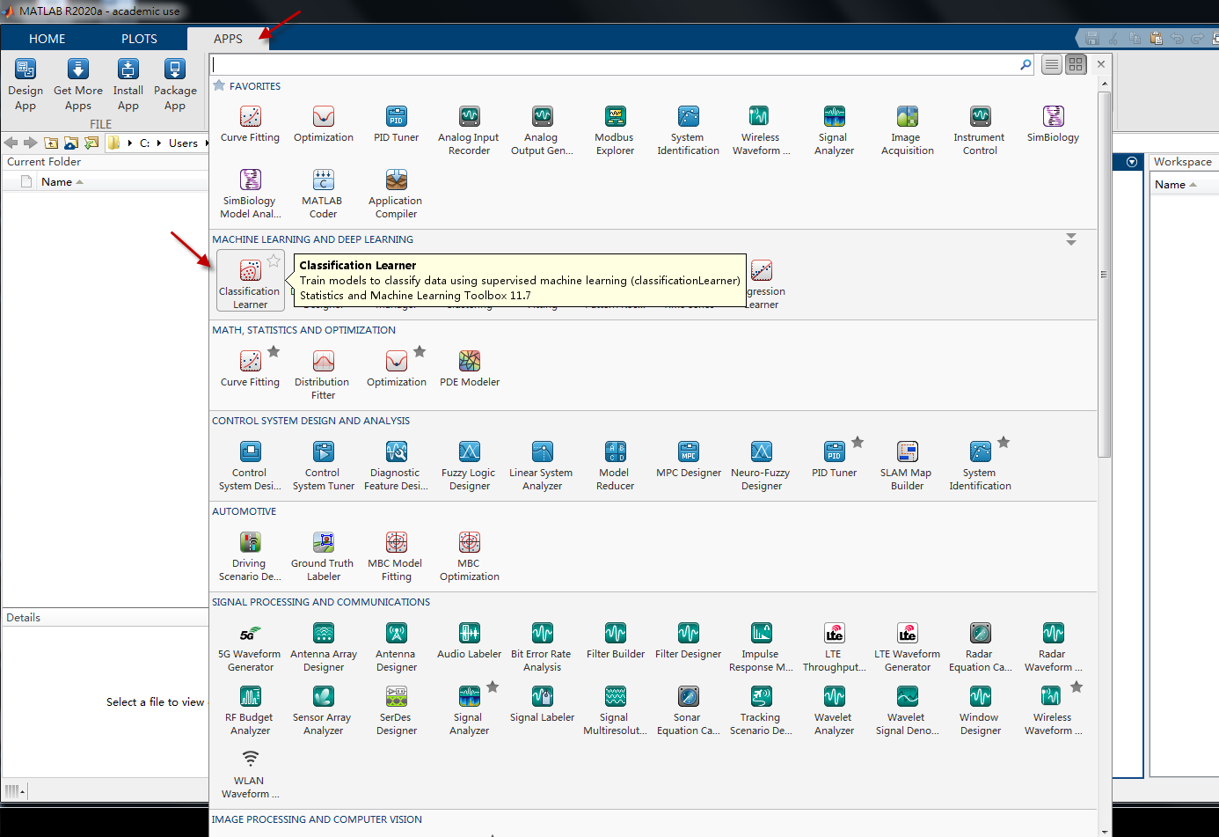

Slide 3
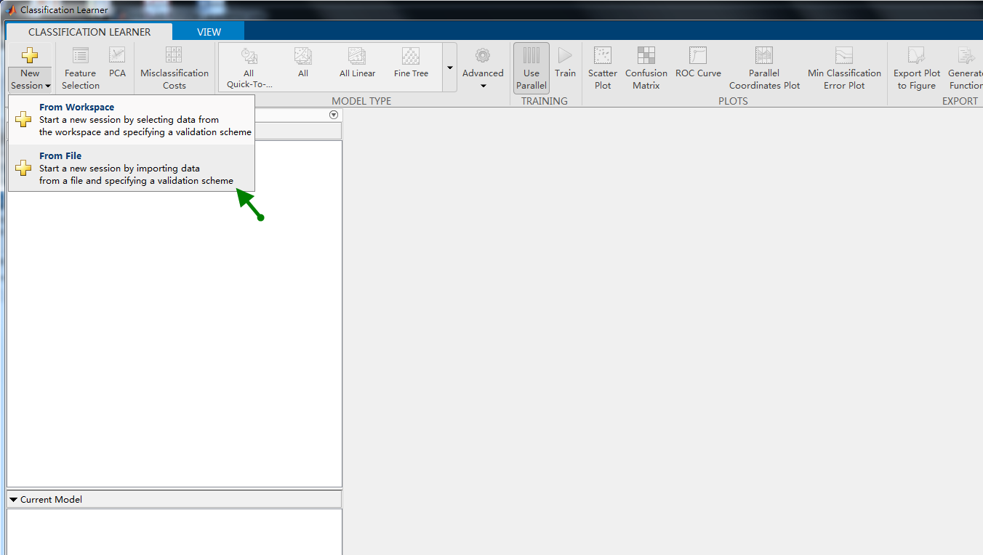

Slide 4
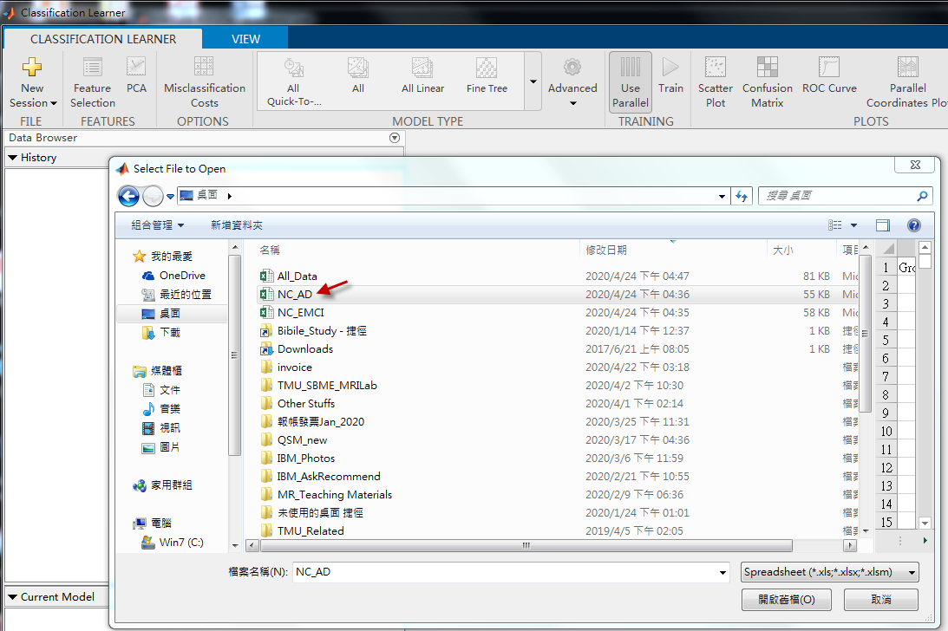

Slide 5
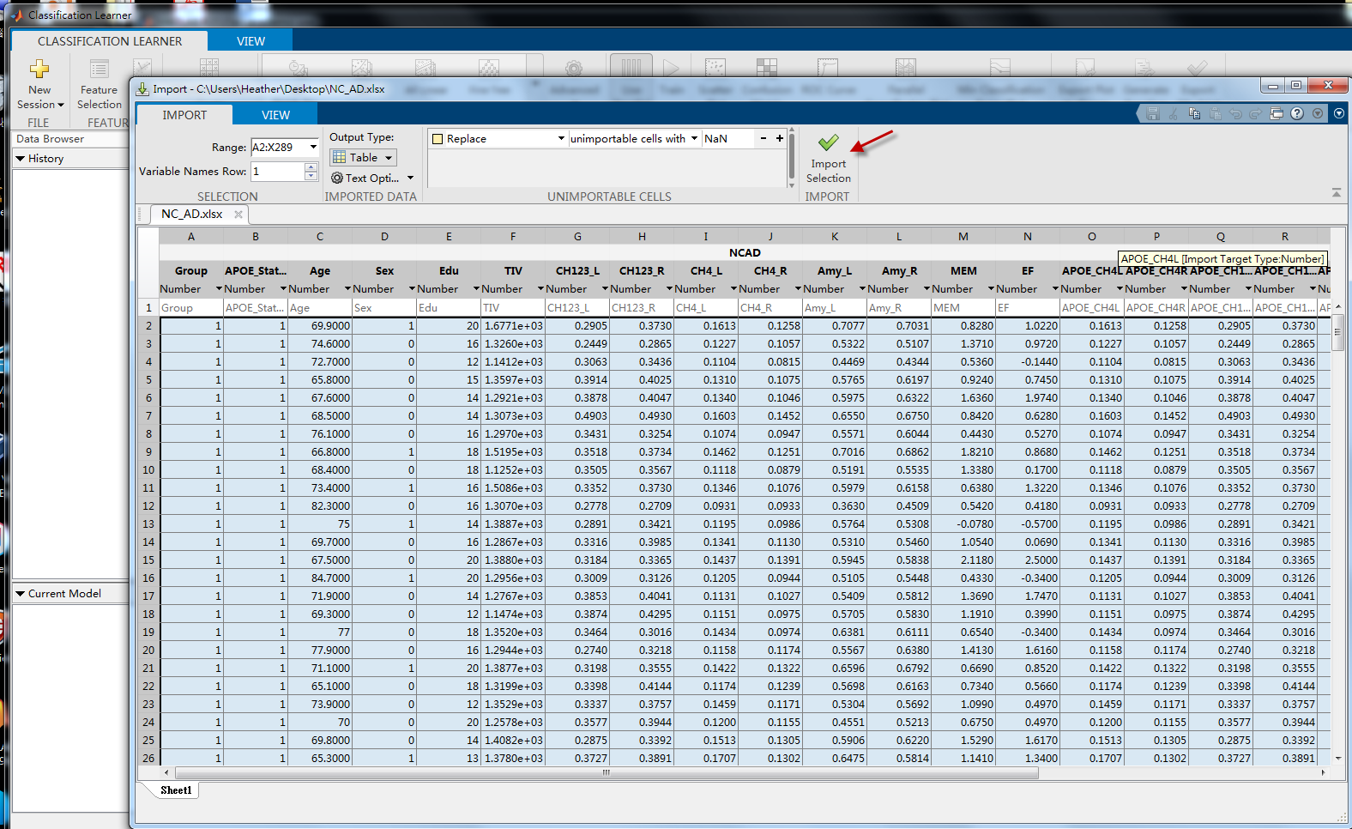

Slide 6
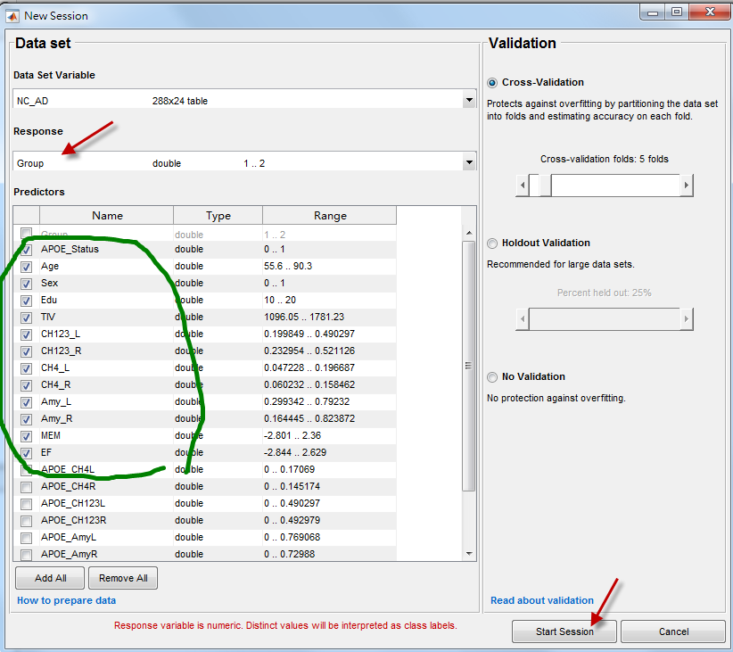

Slide 7
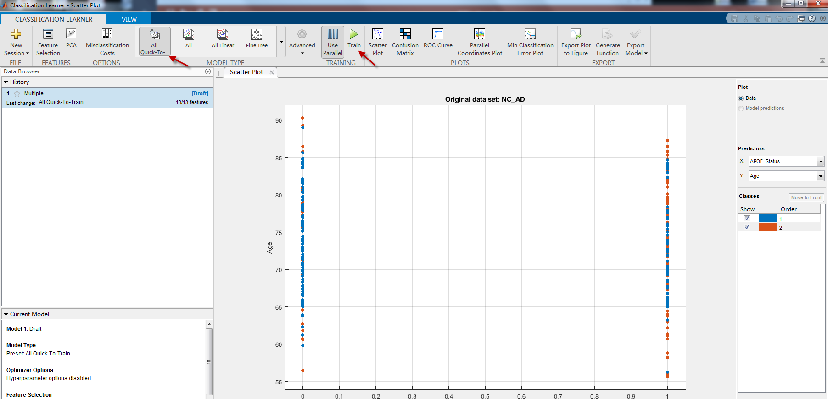

Slide 8
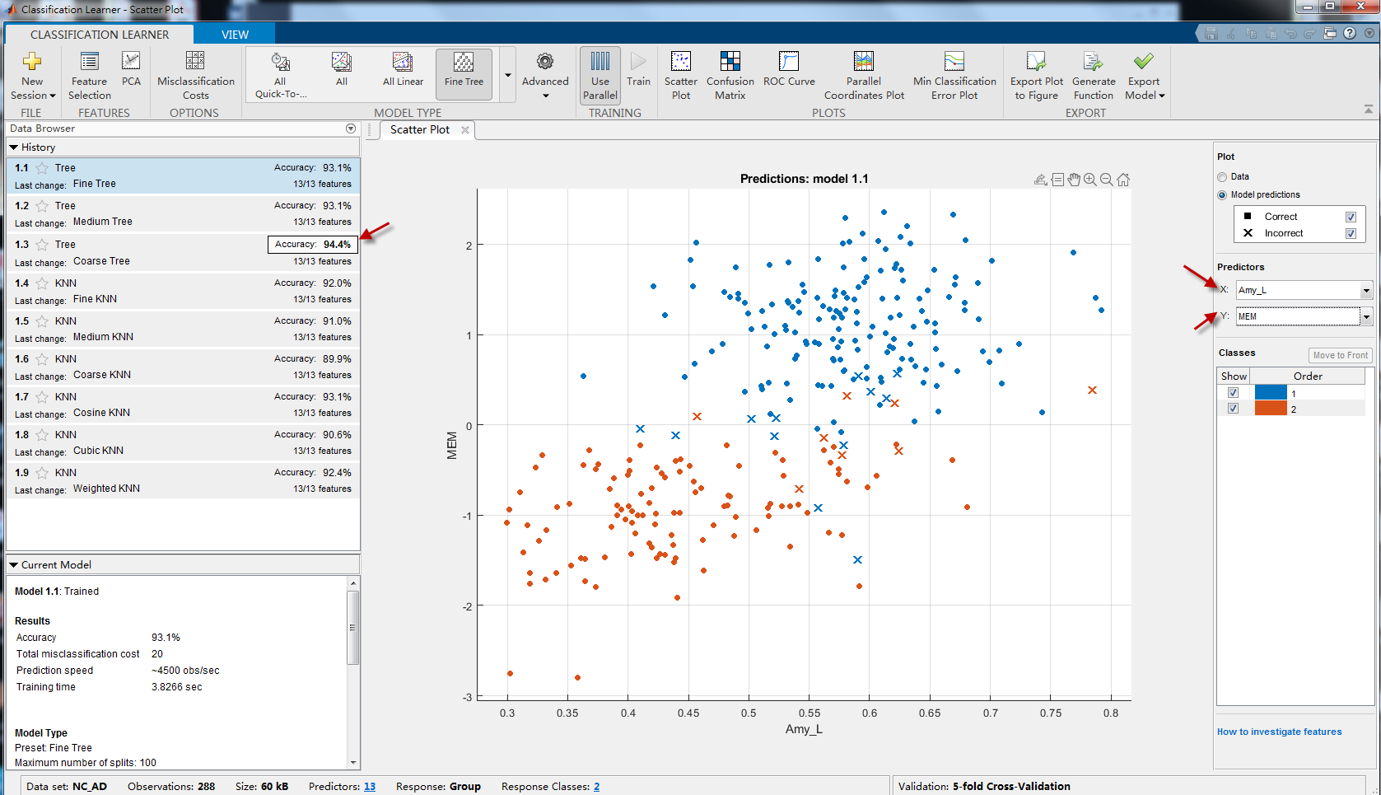

Slide 9
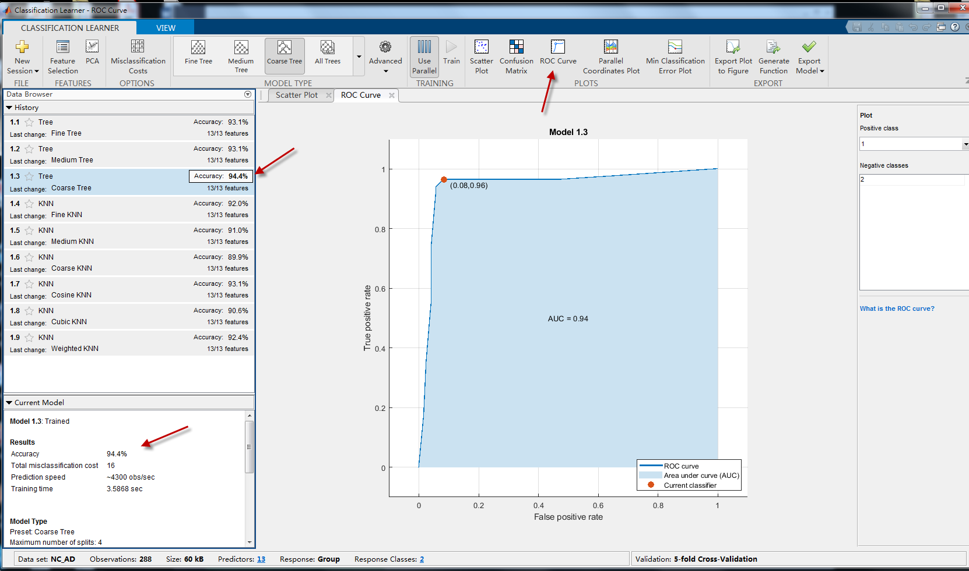

Slide 10
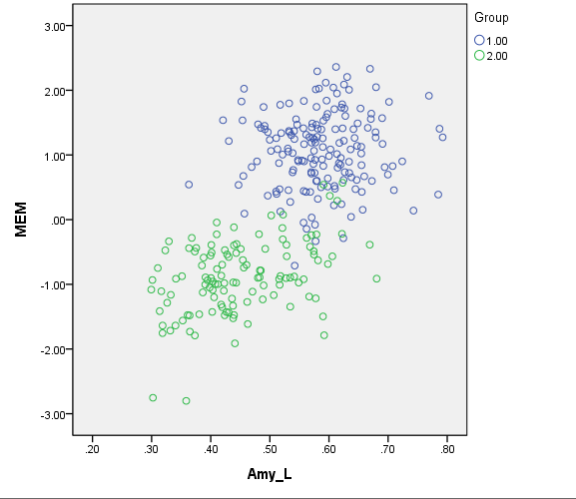
Original scatter plot from SPSS:
Amy_L: left side of amygdala volume
MEM: memory function measurements
Group: 1: normal control, 2: AD patients

